Slide 1



Connect Math HBA
Cosumnes River College
Stat 300

Slide 2
What is Connect Math
Hosted by ALEKS?
With Connect Math, you can complete coursework anytime and anywhere.
Connect Math Hosted by ALEKS combines artificially intelligent, diagnostic assessment with intuitive online learning tools to help you get the most out of your course!
Notes:
2

Slide 3
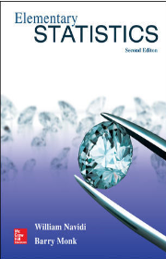
Your Required Materials
Required Materials: Navidi/Monk, Elementary Statistics 2nd Edition with Connect Math
Notes:
NSS Note: If information is not provided by rep, you can delete those areas.
So what do you need to get started.
Here we have the book that your professor will be using to teach the course, the connect product (that comes with Learnsmart) paired with it, as well as the URL you need to log into your class site

Slide 4
Purchasing Options
$120.00*
Package contents (text and Connect Math)
$104.00
Connect Math standalone (ebook only, no print book)
$232.74*
Price of components if purchased separately!
Discounted Price at bookstore
Online purchase price
Save $112.74 by purchasing at the bookstore
*Prices are approximate
Notes:
NSS Note – Price Chart – FILL IN LIST PRICES FOR EACH CATEGORY
NOTE: FOR CHEMISTRY AND ACCOUNTING ONLY INCLUDE CONNECTPLUS PRICES. CONNECT NOT AVAILABLE

Slide 5
Get started in 5 easy steps!
Go to www.connectmath.com.
Click the “Sign up now!” link.
Enter your Course Code (from your instructor).
Enter your access code that came with your book in the bookstore or purchase an access code online.
Fill in the remaining information to complete registration.
Notes:
5

Slide 6
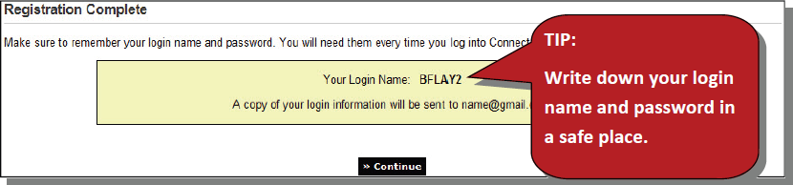
Connect Math HBA
Student Registration

Slide 7
Need Help?
Visit: http://support.connectmath.com
Call: (949) 390-2095
Monday – Thursday | 7 AM – 1 AM
Friday | 7 AM – 9 PM
Sunday | 4 PM – 1 AM
(All times Eastern)
Notes:
7

