Slide 1
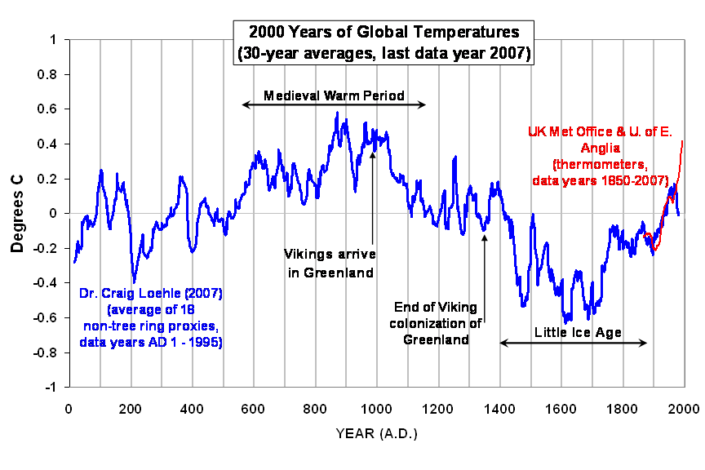

Slide 2
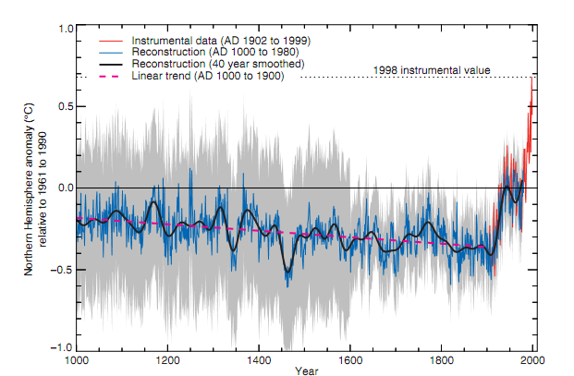
Figure 2.20 in IPCC AR3 (Summary for Policy makers and page 134)
1000 year Northern Hemisphere Temperature Reconstruction

Slide 3
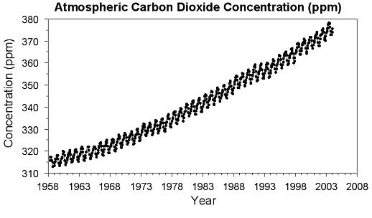

Slide 4
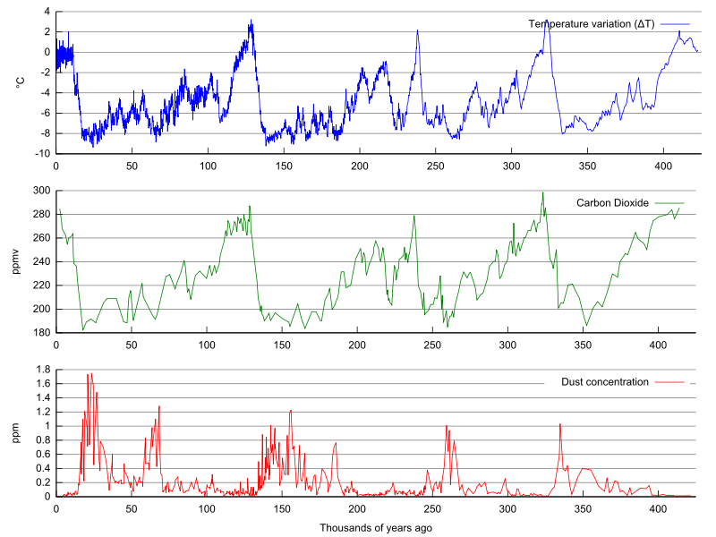
Vostok Petit Ice Core Data

Slide 5
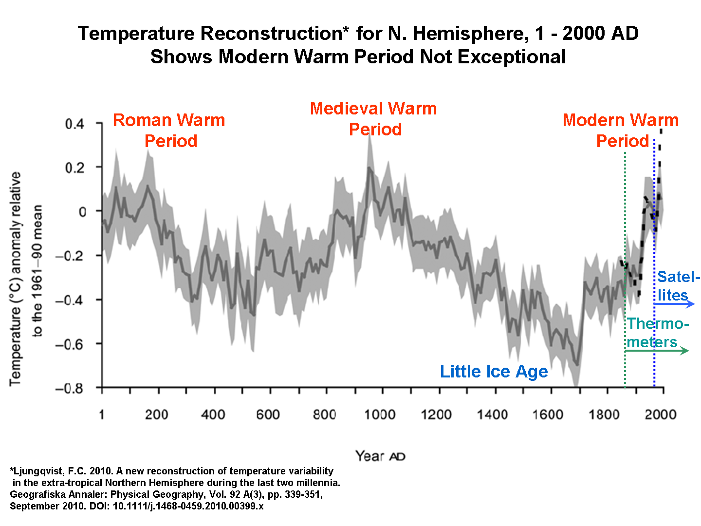

Slide 6
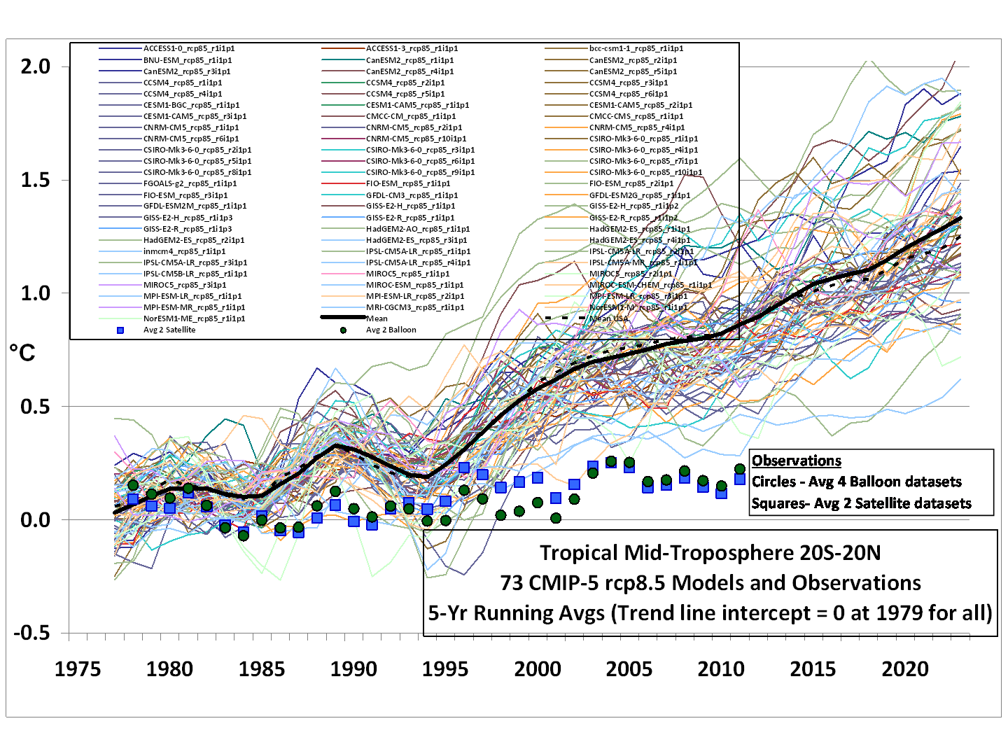

Slide 7
